Slide 1
Lesson 1
Introduction
ICS 3109
Business Process Re-engineering and Change Management

Slide 2
Contents
What is BPR?
Why BPR?
Principles & Methodologies of BPR
Issues & Challenges in BPR
Critical Success/ Failure Factors in BPR
Some case studies of BPR
Conclusion

Slide 3

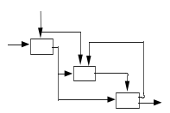



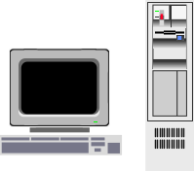
What is BPR?
Business Process Re-engineering or BPR is the analysis and redesign of workflow and processes within and between organizations
- Michael Hammer & James Champy, 1993
Organization
Technology
Process

Slide 4
A Definition of BPR
BPR is the
Fundamental rethinking and
Radical redesign of
Business Processes
to achieve Dramatic improvements in
critical measures of performance
.. such as Cost, Quality, Service and Speed.

Slide 5
Definition of Process
A process is simply a structured, measured set of activities designed to produce a specific output for a particular customers or market.
    -- Thomas Davenport
Characteristics:
  A specific sequencing of work activities across time and place
  A beginning and an end
  Clearly defined inputs and outputs
  Customer-focus
  How the work is done
  Process ownership
  Measurable and meaningful performance

Slide 6
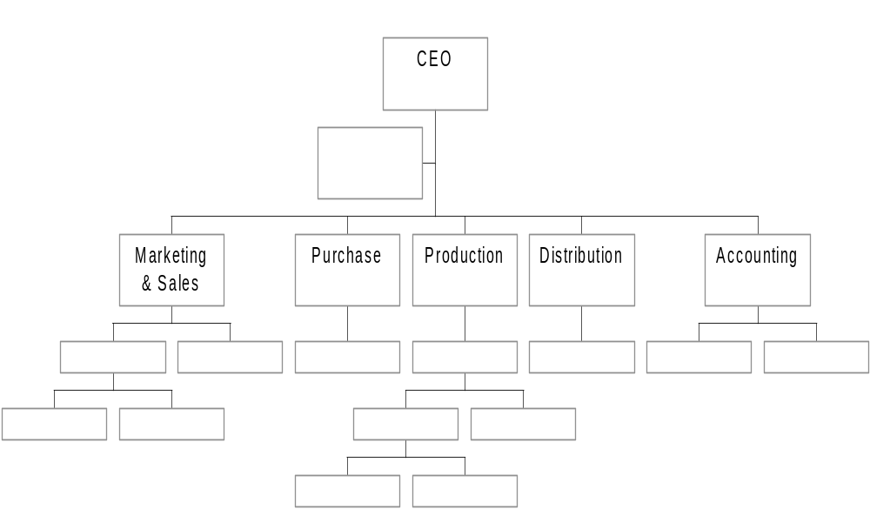


Processes are often Cross-Functional Areas
"Manage the white space on the organization chart!"
Customer/
Markets
Needs
Supplier
Value-added
Products/
Services to
Customers
"We cannot improve or measure the performance of a hierarchical structure. But, we can increase output quality and customer satisfaction, as well as reduce the cost and cycle time of a process to improve it."

Slide 7
What is a Business Process (BP)?
BP is a collection of activities that takes one or more kinds of input and creates an output that is of value to customers
Examples of BP, in the context of e-Government, are:
  Issuance of a Driving License or Passport
  Registration of a Company
  Audit of a Tax Return
  Release of a Grant

Slide 8
Reengineering is not …….
Automation of existing ineffective processes
Sophisticated computerization of obsolete processes
Playing with organization structures
Downsizing – doing less with less

Slide 9
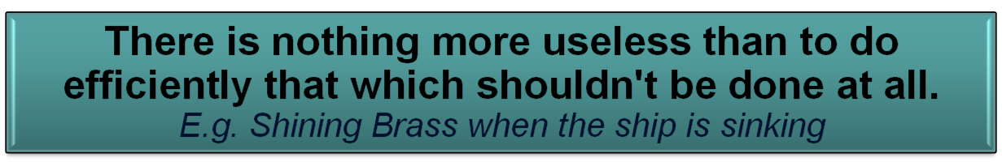
Effectiveness Vs Automation
Automation : use technology to automate the “AS IS” process to make it happen faster - often wrongly perceived as eGovernment.
Effectiveness: To improve service and satisfy customer needs, while lowering costs.
Notes:
So the challenge is to improve service – options, access, speed – in all imaginable ways and at the same time reduce costs
And one option is to throw technology at the problem and automate. This was what the private sector did initially; soon realised that RoI was the victim; corrected by tryinjg to align IT strategy with Business strategy continuously.
As we discussed yesterday that is not eGov

Slide 10
Automation & BPR
Automation is using technological tools to perform OLD processes, in a NEW way.
  Like putting OLD Wine in a NEW bottle.
BPR is about Innovation
  Making NEW Wine and putting it in a NEW bottle

Slide 11
BPR & Quality Initiatives
Quality Initiatives attempt continuous improvement
  Six Sigma
  TQM (Total Quality Management)
BPR attempts a radical redesign or transformation
  Big Bang approach
  Quantum Leap

Slide 12
BPR History
Back in 1911, Frederick Taylor focused on manufacturing tasks and time/motion studies, which were measured statistically.
In order to maximize profits, the primary business drivers were efficiency and minimized cost.
An organization would focus on training its workers to follow specific steps that required narrowly focused skill and endurance.
Standards and controls were mechanistic. Process drivers were maximized around distinct, insular, repeatable tasks. However, given the business environment at that time, the business areas were intentionally siloed.

Slide 13
BPR History
In the 1960s, technology increasingly became a business driver and amplified the speed of change. This launched the first wave of process orientation.
International (Japanese) companies became much more competitive, due, in part, to their focus on quality improvement programs and reduced defects.
US companies started to mirror the quality approach.
The combination of process scrutiny and technological superiority lead to technology as process driver.
American business changed its operational paradigm, and the process era began.

Slide 14
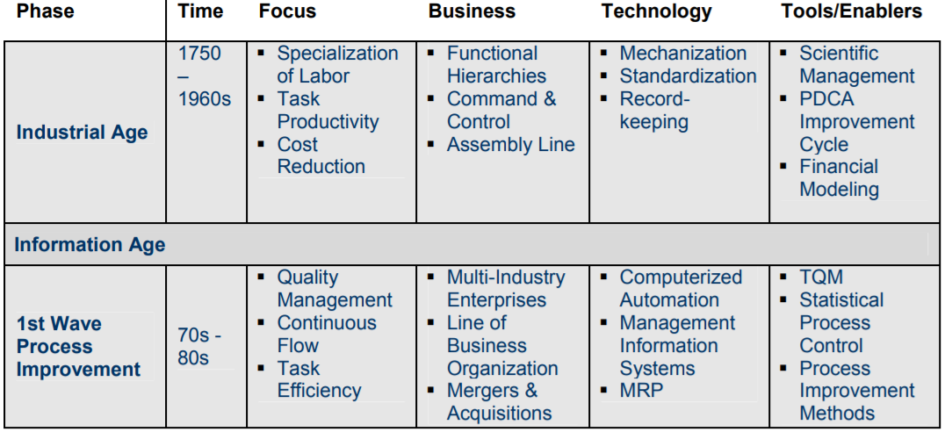
BPR History

Slide 15
BPR History
American business scrutiny of international competition changed focus to measurable processes and to speed that could be combined into “Just in time” manufacturing.
US companies started to mirror the quality approach.
The growing use of computers in the 1970s and 80s combined with procedure specialization that accommodated technological precision in fields such as nuclear power, and led to quantitative statistical software and related data gathering techniques that measured, gathered, and interpreted results.

Slide 16
BPR History
The second wave of process orientation covered the late 1980s to the early 1990s.
Revenue growth returned as American companies leveraged international process practices.
Focus shifted to TQM, and then to ISO compliance standards.
Over a decade of statistical analysis increased the need to manage data in a meaningful way.
The organization shifted from a focus on corporate mission and group brainstorming to cross-functional teams and to handoffs within the organization as the “how” to do tasks replaced the “why.”

Slide 17
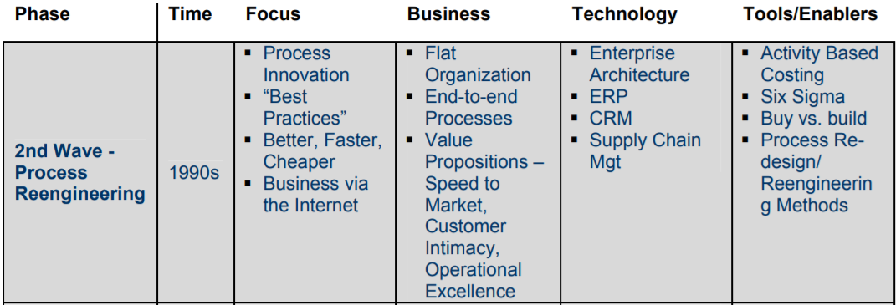
BPR History

Slide 18
BPR History
The third wave began in the mid 1990s and continues in the present as the “coming of age” of process-centric business.
Technology is shifting from being a process driver to a process enabler.
The identity of the customer changed from markets to individuals with customized solutions.
Just-in-time manufacturing of the first wave led to just-in-time supply chains of the third wave, with the accompanying need to understand processes across disparate enterprises.

Slide 19
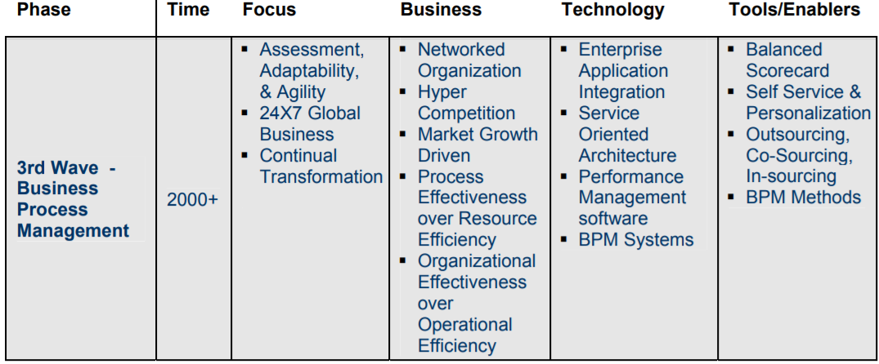
BPR History

Slide 20
BPR History
The company as a system became more important than an examination of its individual parts.
With the advent of thin-client applications and commonly used protocols, applications could be utilized regardless of the operating system or work station.
This allowed “business management” to start to separate from “systems management” and enabled “process management” to exist separate from the systems themselves.

Slide 21
BPR Today
Our challenge now is to establish a context in which to overlay consistent practices, commonly shared principles, acknowledged measurements, and technical solutions as the field continues to evolve.
Therefore, BPR designers must craft a discipline with the same characteristics of flexibility, transparency, and adaptability that corporate businesses intend to establish by using BPR methods.

Slide 22
Why BPR?
The Problem is that
we are governing in the 21st century
with Processes and Organizations
designed in the 19th Century
to work well in the 20th Century!
We need entirely different
PROCESSES & ORGANIZATIONS
for Governance in the 21st Century

Slide 23
Problem restated…
All processes are simple & efficient when originally designed
  User-friendly
  Deploying contemporary tools & techniques
Processes become complex & inefficient with passage of time
  with addition of sub-processes to handle exceptions
  with changes in environment and
  with increase in customer expectations
  with increase in volumes
We need to
Reinvent
the
processes

Slide 24
Symptoms of Poor Governance
Air of Mystification about procedures
Long Queues at delivery points
Multiple Visits to Government Offices
    Pillar-to-Post
Outcome is in Suspense
    OK or NOT OK !
Gatekeepers at every turn
Poor Quality of Service
Service is a Mercy - not a Right
Too many Intermediaries, Shortcuts

Slide 25
5 Symptoms of Poor Processes
Extensive information exchange, data redundancy and re-keying
Huge inventory, buffers and other assets
Too many Controls and Checks
Rework, Iteration & Duplication of work
Complexity, Exceptions & Special cases

Slide 26
Root Causes of
Poor Service Delivery
Legislative
Intent
Process
Problems
Delivery
Channel
Problems
Delivery
Problems
BPR is an important part of the Solution

Slide 27
3 Goals of BPR
Customer Friendliness
  Meeting customer requirements closely
  Providing convenience
Effectiveness
  Outcome-based approach
  Gaining loyalty of customers
  Image and branding
Efficiency
  Cost
  Time
  Effort

Slide 28
12 Attributes of
Customer-friendly Services
Simple
Need-based
Certainty
Speed
Convenience
  Place
  Time
  Channel
Equitable
Responsive
Customer-centric
Quality of Service
Cost-effective
Accessible
Assisted

Slide 29
Principles &
Methodologies of BPR

Slide 30
7 Basic Principles of BPR
Organize around outcomes, not tasks.
Identify all the processes in an organization and prioritize them in order of redesign urgency.
Integrate information processing work into the real work that produces the information.
Treat geographically dispersed resources as though they were centralized.
Link parallel activities in the workflow instead of just integrating their results.
Put the decision point where the work is performed, and build control into the process.
Capture information once and at the source.

Slide 31
The essence of BPR is Transformation

Slide 32
A 4-Pronged Approach to
Transformation
Transforming Process
Transforming Channels
Eliminate
Simplify
Automate
Base on Trust
Integrate
Join Up
Legislate
Multiple Channels
24x7
Access
Common Service Centres
Mobile
Self-Service
Licensed Intermediaries
Transformation
Using Technology
Transforming People
Enterprise Architecture
Standards
Unified Databases
Unified Networks
SOA
Portals
Training
Change Management
CRM skills
Consultation
Empowerment
Education
Awareness

Slide 33
4 Steps in BPR
Understanding the Current Processes
  ‘AS IS’ study – mapping current processes
  Analysis of Root Causes for Inefficiencies
  Identifications of Problems, Issues
Inventing a NEW Process (‘TO BE’ Process)
  Survey of Best Practices
  Consultation of Stakeholders
Constructing the NEW Process
  Bringing in new Laws and Rules
  Adopting Disruptive Technologies
Selling the NEW way of functioning
  Change Management
  Communication Strategy

Slide 34
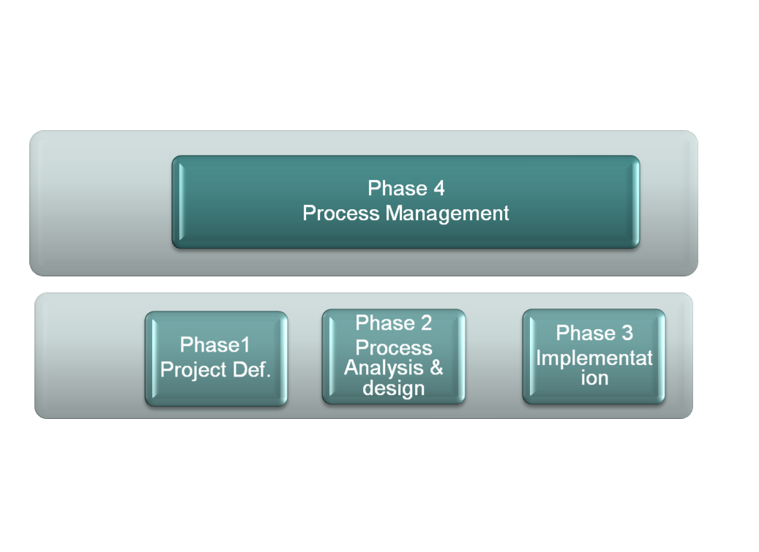
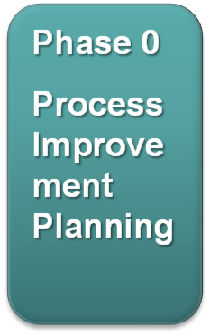
BPR Methodology
Continuous Improvement
Core Processes
Without Issues
Strategy
Core Processes
With Issues
Reengineering - Breakthrough
Improved
Process
Improvement
Plan
Goals, Roles
Boundaries
Implementation
Plan

Slide 35
Challenges,
Critical Success Factors &
Critical Failure Factors
… in BPR

Slide 36
Challenges in a BPR Exercise
Identifying Customer Needs & Performance Problems in the current Processes
Reassessing the Strategic Goals of the Organization
Defining the opportunities for Re-engineering
Managing the BPR initiative
Controlling Risks
Maximizing the Benefits
Managing Organizational Changes
Implementing the re-engineered Processes

Slide 37
9 Changes occasioned by BPR
Work Units change
    from functional departments to process teams
Jobs change
    from simple tasks to multi-dimensional work
People’s roles change
    from controlled to empowered
Job preparation changes
    from training to education
Measures of Performance & compensation change
    from activity to results
Criteria for career advancement change
    from performance to ability
Values change
    from protective to productive
Organizational Structures change
    from hierarchical to flat
Executives change
    from scorekeepers to leaders

Slide 38
Critical Success Factors in BPR
Clear Vision for Transformation
Top management commitment
Identification of Core Processes for BPR
Ambitious BPR team
Knowledge of Reengineering techniques
Engaging external consultants
Tolerance of “genuine failures"
Change Management

Slide 39
Critical Failure Factors in BPR
Trying to fix a process instead of changing it
Lack of focus on Business-critical Processes
Lack of holistic approach
Willingness to settle for minor results
Quitting too early
Limiting the scope of BPR by existing constraints
Dominance of existing corporate culture
Adopting bottom-up approach
Poor leadership
Trying to avoid making anyone unhappy
Dragging the BPR exercise too long.

Slide 40
An Example of BPR

Slide 41
Land Records in India
– Existing System (AS IS)
Legacy of British System
    Land Records created mainly for ‘Land Revenue’
Based on ‘Presumptive Ownership’ of land parcels
Managed by multiple departments
    Title
    Survey
    Registration
    Local Government
Processes & services, mostly manual
Citizens have to visit several offices & wait for months for title changes

Slide 42
Existing System – Land Transactions
Cannot verify ownership
Registration of deeds
Buyer & Seller
Complete Documents
Verify documents and register
Buyer & Seller
Buyer gets proof of transaction
Submit
Appln.
Pay fees
Land Title Office
Submit
Appln for Mutation.
Verify and change records
Buyer gets ownership records
Buyer
Complete application
Buyer
Land Surveyor
Submit
Appln for
Sub-division
Sub-divide the parcel and change records
Buyer gets boundary info.
Buyer
Complete appl.
Buyer

Slide 43
International Best Practices in
Land Records Management
New Zealand
  – Land Information Online
Canada
  – Land Title & Survey Authority
Singapore
  – Singapore Land Authority
Australia
  – Land Victoria

Slide 44
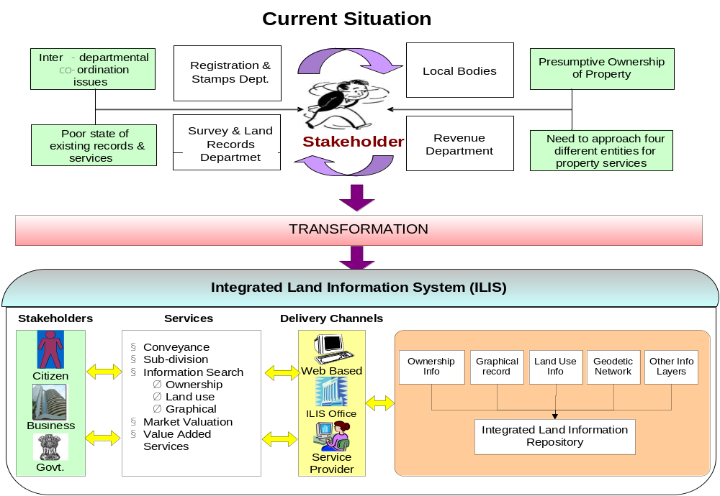
Vision of BPR – Integrated Land Information

Slide 45


Ford Accounts Payable Process*
Purchasing
Vendor
Purchase order
Receiving
Goods
Copy of
purchase
order
Receiving
document
Accounts
Payable
Invoice
Payment
?
?
PO = Receiving Doc. = Invoice
*Source: Hammer and Champy, 1993

Slide 46
Trigger for Ford’s AP Reengineering
Mazda only uses 1/5 personnel to do the same AP. (Ford: 500; Mazda: 5)
When goods arrive at the loading dock at Mazda:
  Use bar-code reader is used to read delivery data.
  Inventory data are updated.
  Production schedules may be rescheduled if necessary.
  Send electronic payment to the supplier.

Slide 47

Ford Procurement Process
Purchasing
Vendor
Purchase order
Receiving
Goods
Purchase
order
Goods
received
Accounts
Payable
Data base
Payment

Slide 48
Ford Accounts Payable
Before
More than 500 accounts payable clerks matched purchase order, receiving documents, and invoices and then issued payment.
It was slow and cumbersome.
Mismatches were common.
After
Reengineer “procurement” instead of AP process.
The new process cuts head count in AP by 75%.
Invoices are eliminated.
Matching is computerized.
Accuracy is improved.

Slide 49


New Life Insurance Policy Application Process at Mutual Benefits Life Before Reengineering*
. . . .
Department A
Step 1
Department A
Step 2
Issuance
Application
Mutual Benefits Life Before Reengineering*
Issuance
Policy
Department E
Step 19
30 steps, 5 departments, 19 persons
Issuance application processing cycle time: 24 hours minimum; average 22 days
Only 17 minutes in actually processing the application
*Source: Rethinking the Corporate Workplace: Case Manager at Mutual Benefit Life, Harvard Business School case 9-492-015, 1991.

Slide 50

The New Life Insurance Policy Application Process Handled by Case Managers
Mainframe
Physician
Underwriter
LAN
Server
Case Manager
PC
Workstation
application processing cycle time: 4 hours minimum; 2-5 days average
Application handling capacity double
Cut 100 field office positions

Slide 51
Capital Holding Co. - Direct Response Group*
A direct marketer of insurance-life, health, property, and casualty-via television, telephone, and direct mail.
In 1988, DRG president Norm Phelps and other senior executives decided that for our company, the days of mass marketing were over.
Need to strengthen DRG's relationships with existing customers and target our marketing to those potential customers whose profiles matched specific company strategies.
A new vision for DRG: The company needed to be exactly what most people didn't expect it to be an insurance company that cares about its customers and wants to give them the best possible value for their premium dollar.
*Source: Capital Holding Corporation-Reengineering the Direct Response Group, Harvard Business School case 192-001, 1992.

Slide 52
Capital Holding Co.: Vision
Caring, Listening, Satisfying... one by one
Each of us is devoted to satisfying the financial concerns of every member of our customer family by:
Deeply caring about and understanding each member’s unique financial concerns.
Providing value through products and services that meet each member’s financial concerns.
Responding with the clear information, personal attention and respect to which each member is entitled.
Nurturing an enduring relationship that earns each member’s loyalty and recommendation.

Slide 53
New Business Model: A Conceptual Breakthrough
Market Management
Target & Segment
of Aggregate Market
Use Group
Information
“I Think I Know.”
Use Individual
Information
Prospects
Customers
&
Capture Individual
Information
“I Know for Sure.”
Sell &
Renew
Personalized
Service
Customer Management

Slide 54


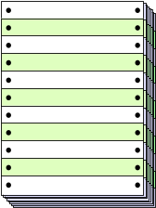


A High-Level Service Process Model Today
Increase my A&H coverage
Give me information about my Life Policy beneficiaries
CSR Life A&H Micro- Data Letter- System
Customer Corres. Policy film Entry shop
        Change
Customer
receives
two separate
responses
Day 8
Action
Request
Input
Requested
Change
What’s your
policy #’s?
Day 2
A&H change
confirmation letter
mailed to customer
Day 5
Action
Request
Challis 3
Day 6
Day 1
System
Update
Life 70
Micro-film
Request
Day 6
(Batch)
Life Policy
beneficiaries letter mailed to customer
Micro-film
Response
Day 5

Slide 55

Customer Management Team (CMT): A Flavor of How DRG Service Process Will Change
Increase my A&H coverage
Give me information about my Life Policy beneficiaries
CMT:
Teleservice
Representative
System:
Client-server
architecture
Customer
Day 1
Day 1
Answers
Immediate
Response to
Customer
Day 1-2
Day 3-4
Send written
acknowledgment
Outbound
Paper

Slide 56
Conclusion
BPR is about Radical Redesign of business processes
BPR brings Efficiency, Effectiveness & Customer-friendliness
BPR needs adoption of a structured methodology
Top management commitment & Change Management are critical to success

